Slide 1
INTERVIEW TRAINER AGENT
IBM AICTE PROJECT
Presented By:
Student Name – Adarsh Kumar Tiwari
College Name – Shri Ramswaroop Memorial University
Department – B.Tech (CSE)

Slide 2
OUTLINE
Problem Statement
Technology used
Wow factor
End users
Result
Conclusion
Git-hub Link
Future scope
IBM Certifications

Slide 3
Problem Statement
Job seekers often face challenges in preparing for interviews due to a lack of personalized, up-to-date resources, limited feedback, and difficulty finding relevant technical and behavioral questions for their target roles.
Proposed Solution:
An AI-powered Interview Trainer Agent using Retrieval-Augmented Generation (RAG), IBM Granite, and IBM Cloud Lite. It offers role-specific question sets, tailored feedback, and improvement strategies, helping candidates excel in interviews by simulating realistic scenarios and offering actionable insights.

Slide 4
Technology used
IBM Cloud Lite Services (APIs, Object Storage, Functions)
IBM Granite Foundation Model
Retrieval-Augmented Generation (RAG)
Natural Language Processing (NLP)

Slide 5
IBM cloud services used
IBM Cloud Watsonx AI Studio
IBM Cloud Watsonx AI Runtime
IBM Cloud Agent Lab
IBM Granite Foundation Model

Slide 6
Wow factors
This agent revolutionizes interview preparation by delivering a deeply personalized and up-to-date coaching experience. It stands out by using advanced AI and IBM Cloud technologies to ensure every user gets targeted, actionable, and adaptive support throughout their journey.
Key Wow Factors:
Delivers custom-tailored interview questions based on user resume, job title, experience level, and intended role.
Retrieves the latest role-specific and company-specific questions from real recruitment databases, ensuring every mock interview is highly relevant.
Real-time feedback powered by IBM Granite: Instantly analyzes responses (both technical and soft skills), suggests improvements, and boosts communication effectiveness.
Continuously adapts to new trends: Uses Retrieval-Augmented Generation (RAG) to stay on top of evolving interview tactics and hiring practices.
Builds user confidence: Guides users through realistic behavioral scenarios, HR guidelines, and industry standards for a holistic prep.
Progress tracking and analytics: Provides insights into improvement areas, helping users target efforts where they matter most.
Enterprise-ready scalability: Handles multiple users securely and efficiently through IBM Cloud, with privacy for all training data.

Slide 7
End users
Job Seekers (Freshers & Experienced)
Students & Placement Cells
Career Counseling Services
HR Professionals (For internal mock interviews)
Coding Bootcamp Participants

Slide 8
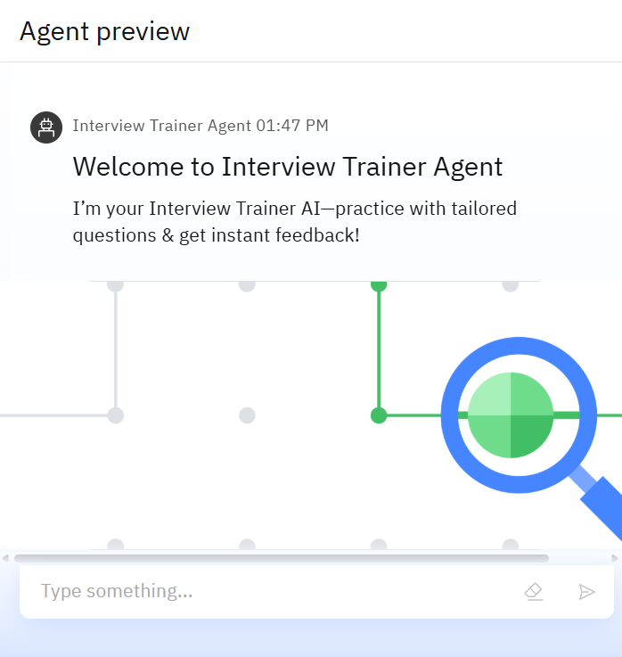
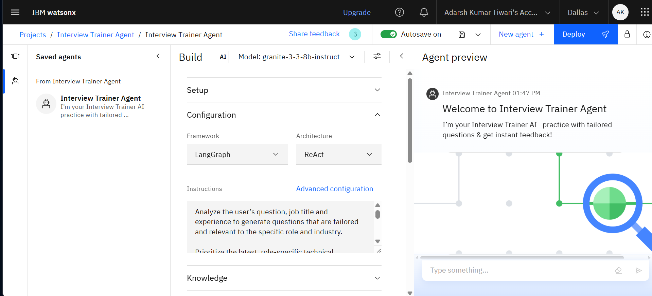
Results

Slide 9
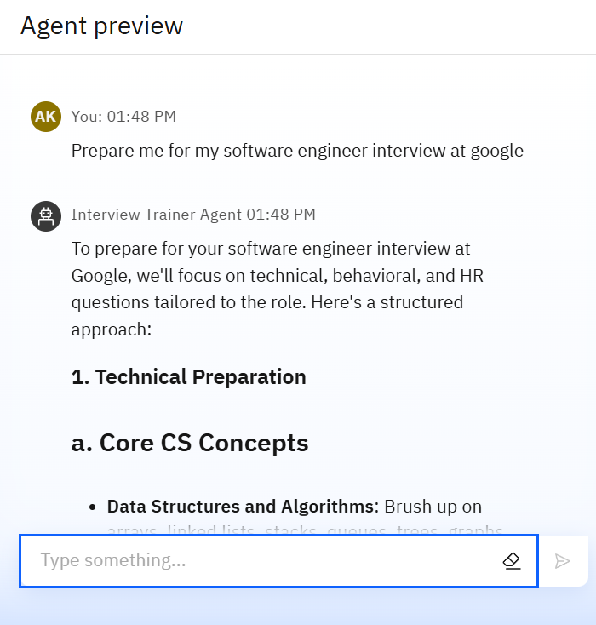
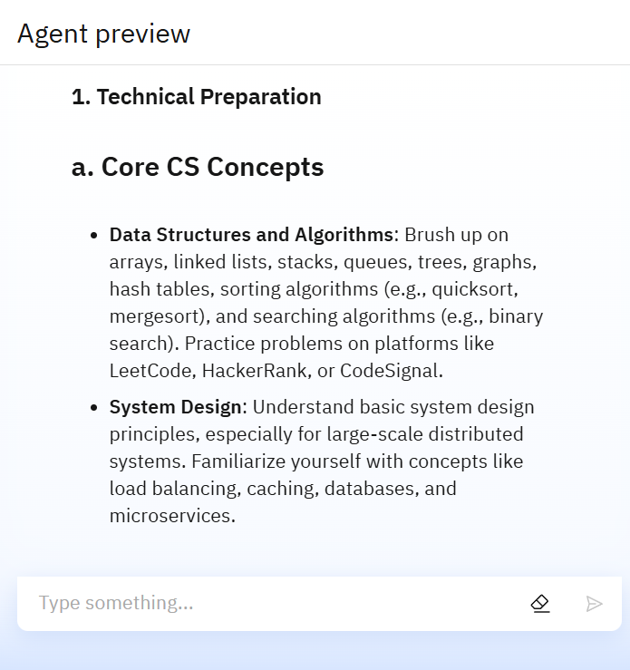
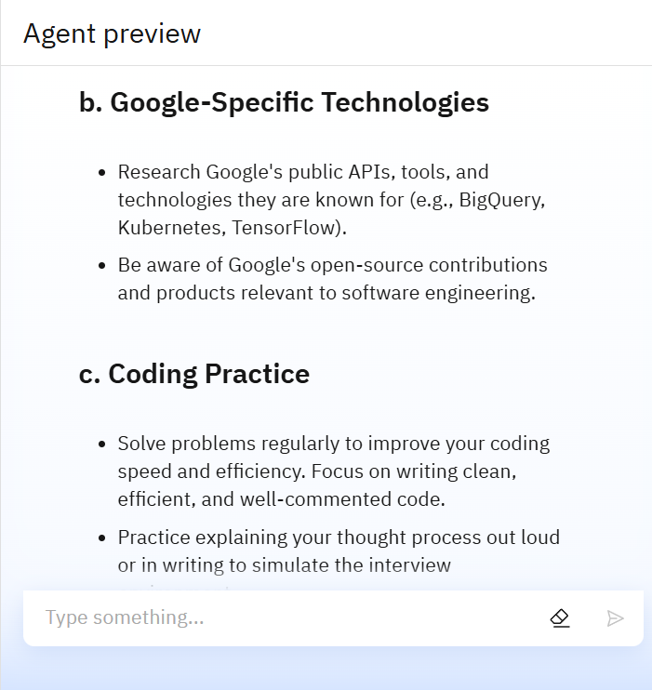
Results

Slide 10
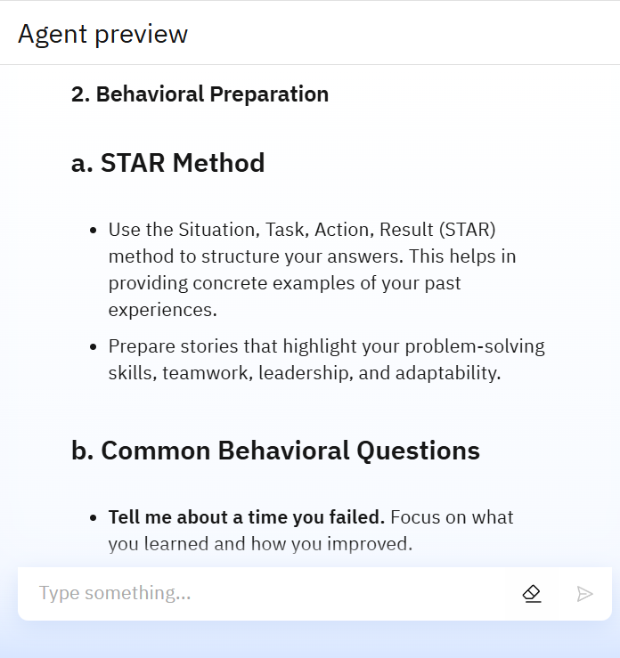
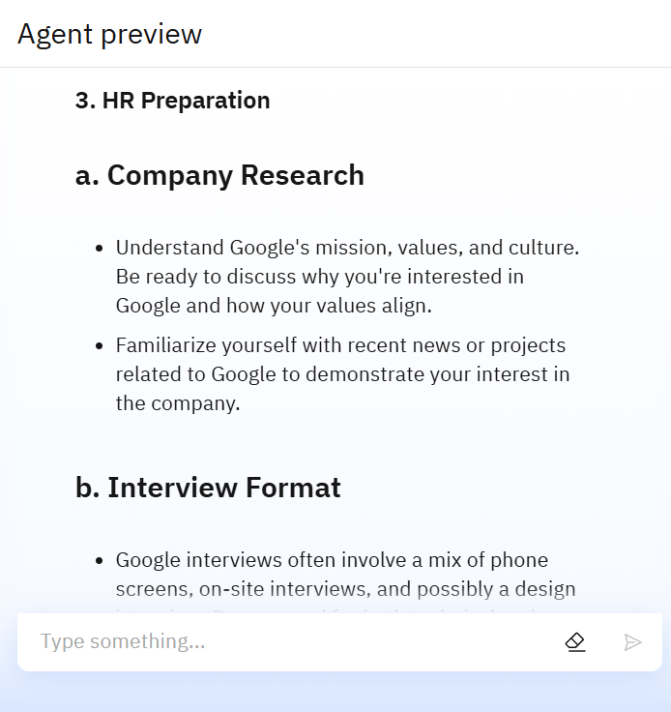
Results

Slide 11
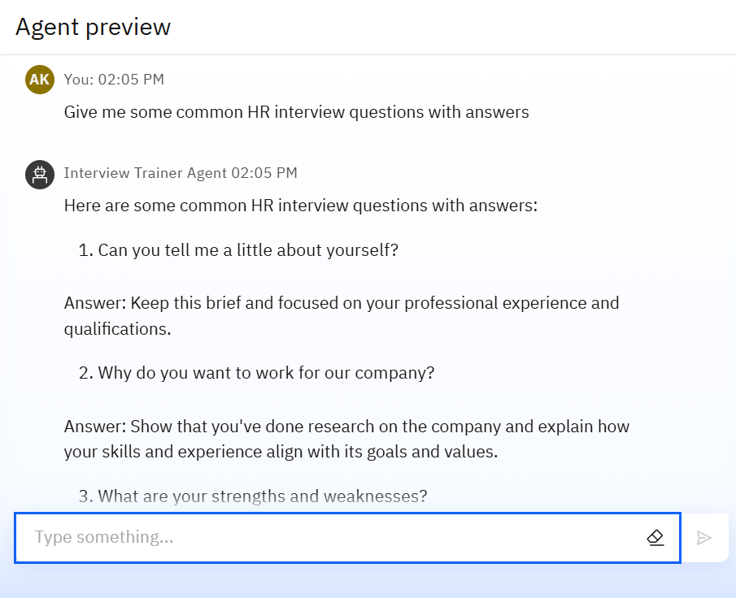
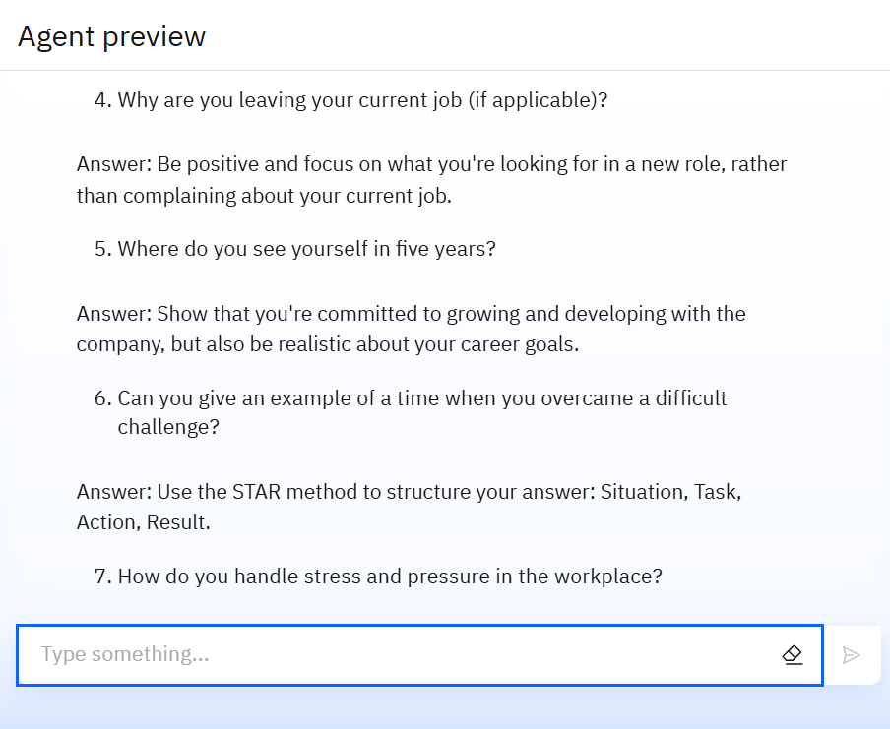
Results

Slide 12
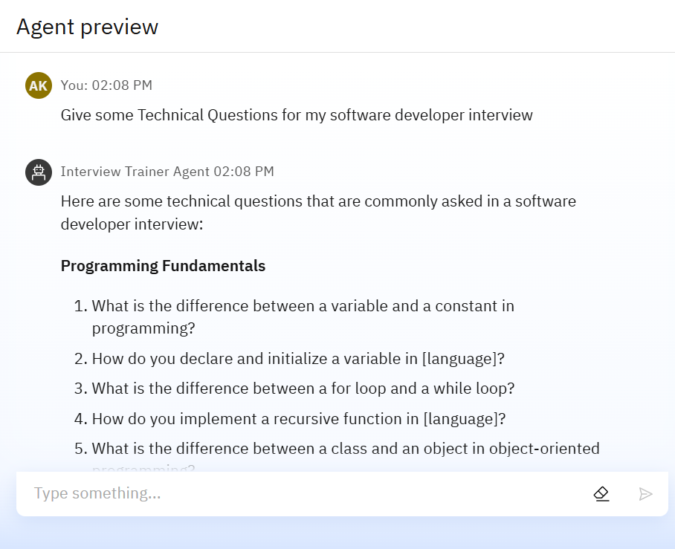
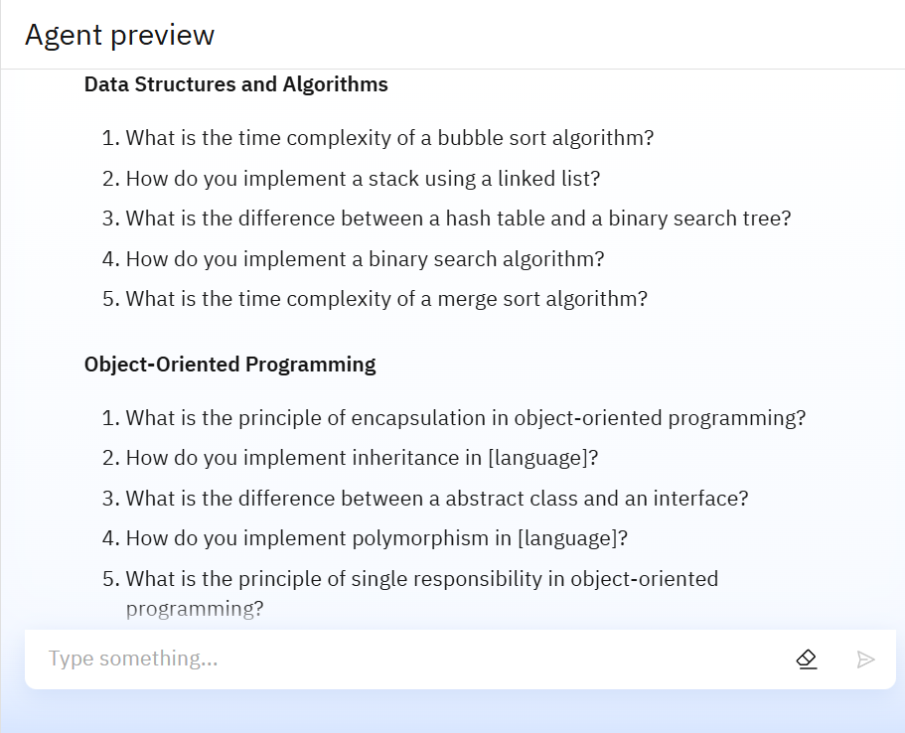
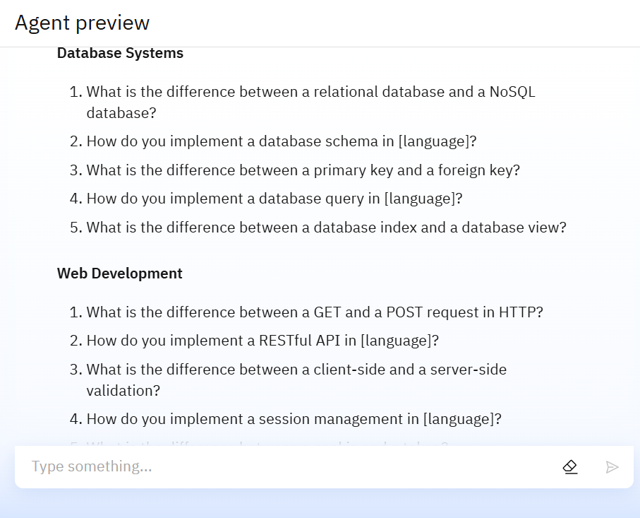
Results

Slide 13
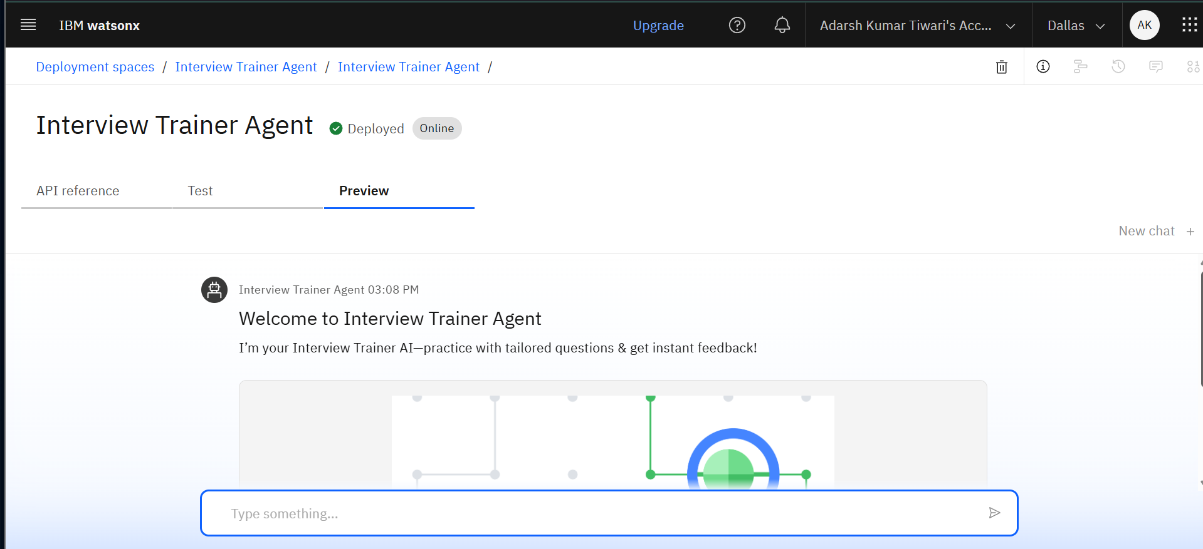
Results
Deployed AI Agent

Slide 14
Conclusion
The Interview Trainer Agent automates and personalizes the interview preparation process.
Delivers targeted, up-to-date, and role-specific mock interviews.
Accelerates user readiness and boosts success rates with continuous feedback.
Demonstrates the practical application of IBM Granite and IBM Cloud Lite in real-world career enablement.

Slide 15
GitHub Link
GitHub Link: https://github.com/Adarshh18/Interview-Trainer-AI-Agent

Slide 16
Future scope
Multilingual Support for global job seekers.
Voice-based interview simulation.
Integration with LinkedIn and career portals.
Company-specific interview/coding task generator.
AI-based progress tracking dashboard.
Mock group discussions and HR panel interviews.

Slide 17
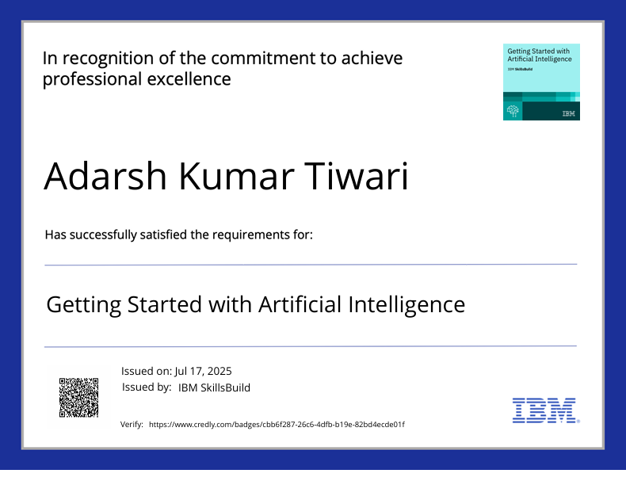
IBM Certifications

Slide 18
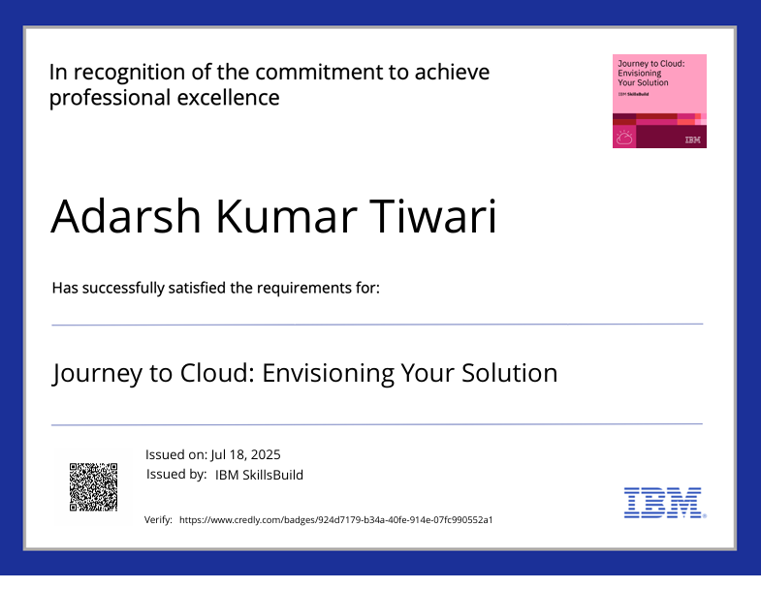
IBM Certifications

Slide 19
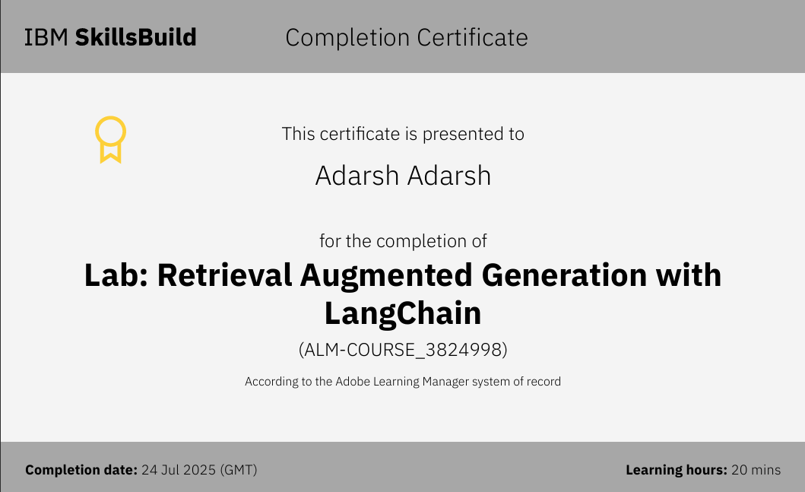
IBM Certifications

Slide 20
THANK YOU

